Slide 1

Module 0
Python Programming
Notes:
Guidelines
Use section headers to chunk content in your presentation.
Use the same style of section header throughout your presentation.
Keep your title to no more than 2 lines.

Slide 2

Python Basics
Notes:
Guidelines
Use a title slide at the beginning of your presentation. There are 9 variations of title slides to choose from.
If you will have a series of slideshows, we recommend using the same style of title slide for each presentation.
Keep your title to no more than 2 lines.
Do not change the font style or font size of the title or subtitle.

Slide 3
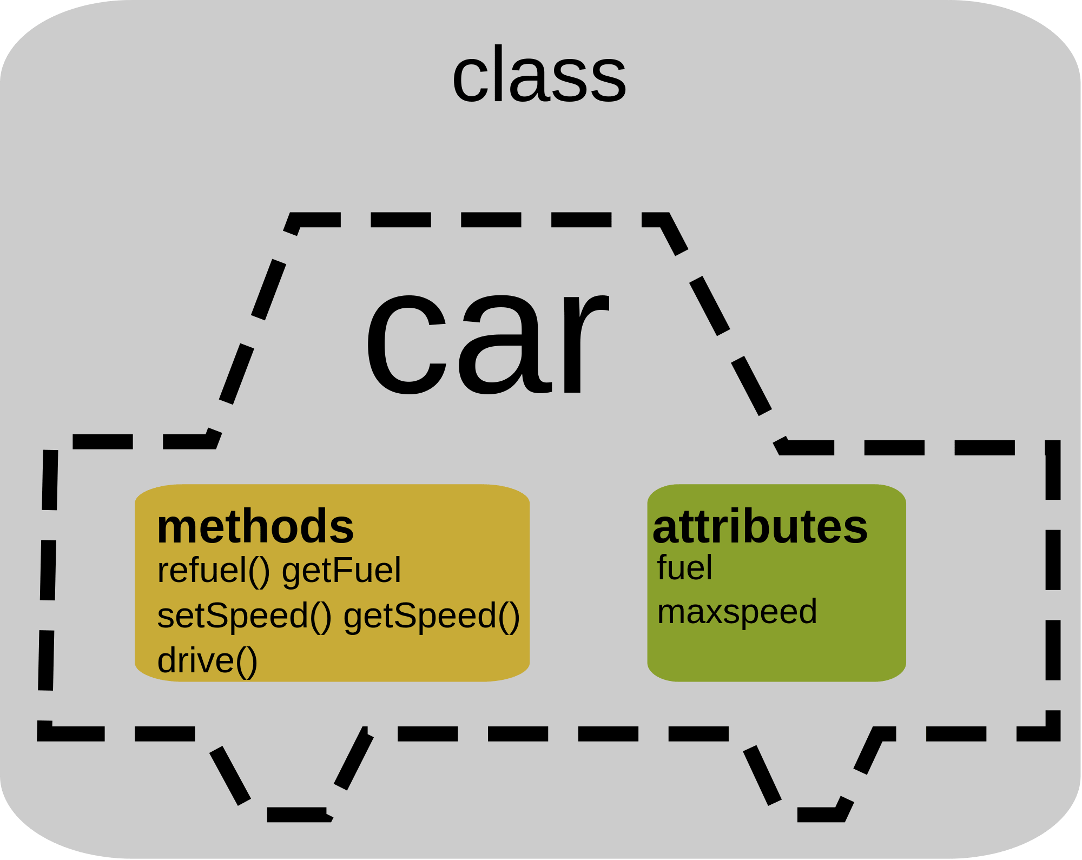
Objects and Classes
Objects are encapsulations of variables and functions into single entity
Classes provide a way to group information into a single unit
Can combine multiple attributes into a single object
Classes contain methods (functions) and attributes (values)

Slide 4
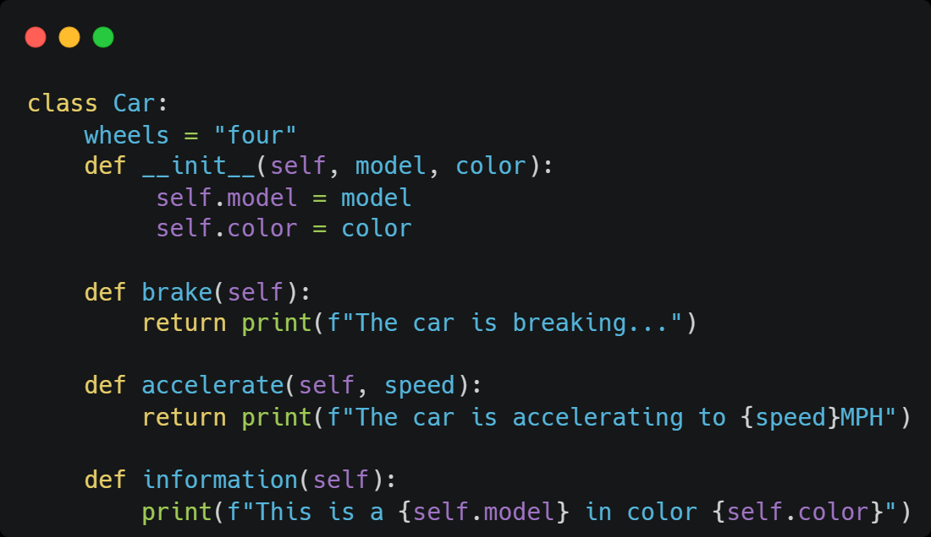
Example
Class Car

Slide 5
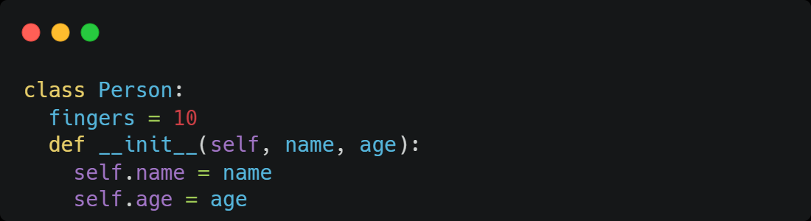
Attributes
Characteristics that can be accessed from other objects
Can be mutable or immutable

Slide 6
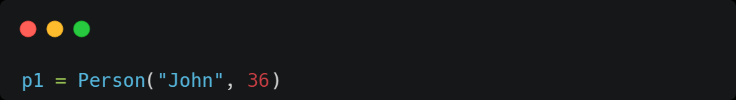
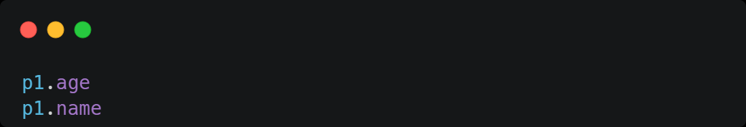
Making an Instance (Instantiate)
Creating an instance object from the class

Slide 7
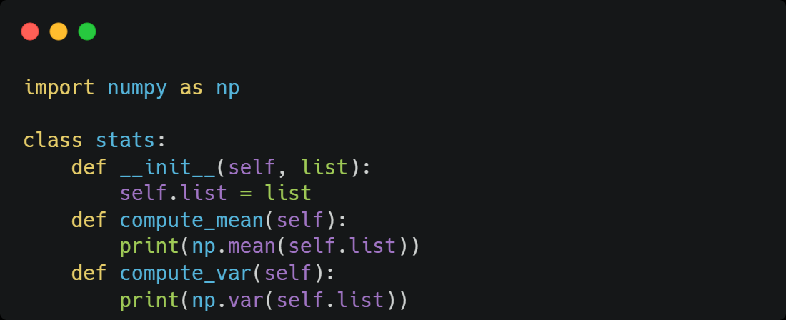

Methods
Enable classes to implement functions

Slide 8


Methods
Calling a method bound to the class
3.0
2.0

Slide 9
Linear Regression Example
We minimize the sum of squared errors (SSE).

Slide 10
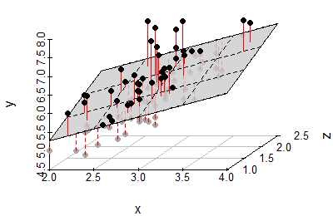

Linear Regression Example
The vector of estimates can be fit with $\hat{β}={\left(X^{⊤}X\right)}^{−1 }(X^{⊤}y)$
The predictions can be obtained with $\hat{y}=X\hat{β}$

Slide 11
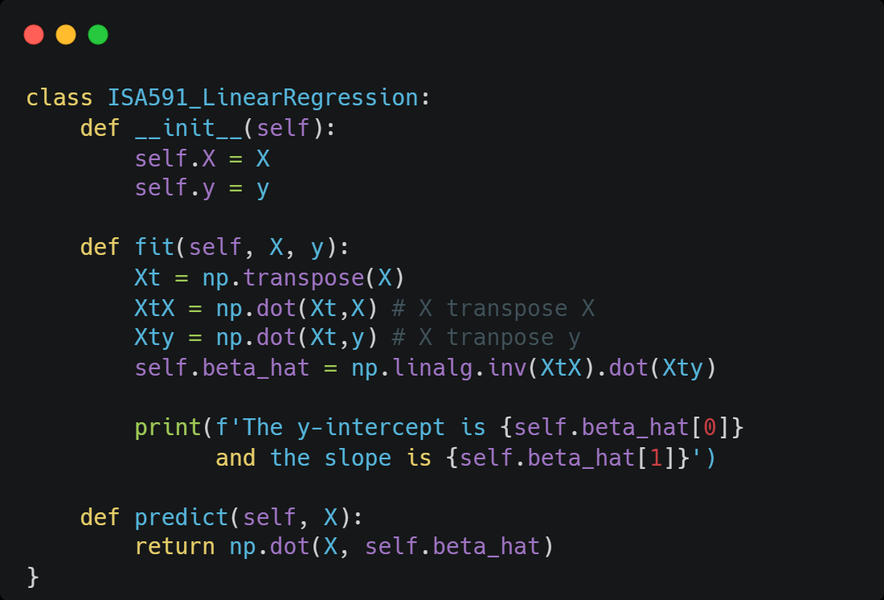
Linear Regression Example
Class implementation

Slide 12
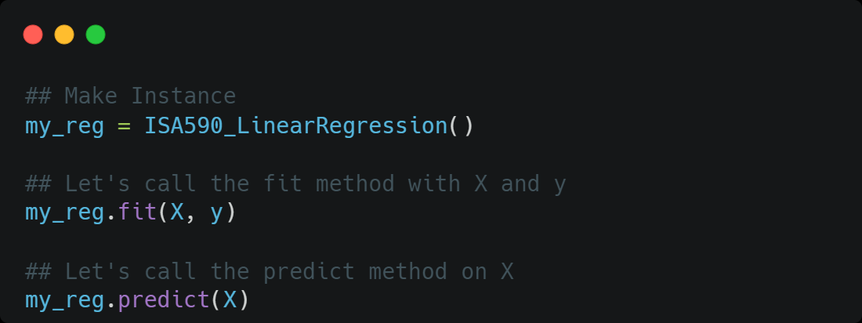
Linear Regression Example
Class implementation

